Slide 1


SNS COLLEGE OF ENGINEERING
Kurumbapalayam (Po), Coimbatore – 641 107
An Autonomous Institution
Accredited by NBA – AICTE and Accredited by NAAC – UGC with ‘A’ Grade
Approved by AICTE, New Delhi & Affiliated to Anna University, Chennai
DEPARTMENT OF COMPUTER SCIENCE AND ENGINEERING
Design of Attendance Monitoring System
Using RFID
Project Members
V.Sanjay Giridhar [713317104042]
V.Shamaladevi [713317104046]
Project Guide
K. Aravindhan
Assistant Professor
Department of Computer Science and Engineering
SNS College of Engineering

Slide 2
ABSTRACT
This Attendance System With Storing Data on Google Spreadsheet Using RFID and Arduino Ethernet Shield. Now a days attendance management system is one of main thing in any organization. The pervious attendance system is too cost in this mainly we are reducing cost.
To make an attendance system based on RFID reader which will save attendance data in real time to google spreadsheet.
The objective of this system is to get the data in google sheet. And also we are not using a specific server to it we are using Google Cloud Platform to store Data.
The main objective is to reduce cost and to give simpler and efficient one.

Slide 3
Literature survey
TITLE | CONTENT | PUBLICATION
Attendance fingerprint identification system using Arduino and single board computer | Fingerprint is one of the most unique parts of the human body that distinguishes one person from others and is easily accessed. This uniqueness is supported by technology that can automatically identify or recognize a person called fingerprint sensor. Yet, the existing Fingerprint Sensor can only do fingerprint identification on one machine. For the mentioned reason, we need a method to be able to recognize each user in a different fingerprint sensor. The purpose of this research is to build fingerprint sensor system for fingerprint data management to be centralized so identification can be done in each Fingerprint Sensor. The result of this research shows that by using Arduino and Raspberry Pi, data processing can be centralized so that fingerprint identification can be done in each fingerprint sensor with 98.5 % success rate of centralized server recording. | International Journal of Recent Technology and Engineering (IJRTE) ISSN: 2277-3878, Volume-8 Issue-4, November 20192nd International Conference on Computing and Applied Informatics 2017 IOP Publishing IOP Conf. Series: Journal of Physics: Conf. Series 978 (2018) 012060 doi :10.1088/1742- 6596/978/1/012060

Slide 4
TITLE | CONTENT | PUBLICATION
Fingerprint Based Attendance System Using Arduino | Attendance system is required in many different places such as offices, companies, schools, organizations and institutions, etc. There are many attendance systems to take attendance. But, every place need to have a good system. This paper describes one of the attendance systems. The main objective of this paper is to study and construct the attendance system using fingerprint module. In this system, Arduino UNO controller and PLX DAQ tool are the main components to display the record on Excel. | DOI: 10.29322/IJSRP.8.7.2018.p7967 http://dx.doi.org/10.29322/IJSRP.8.7.2018.p7967 Design and Development of Portable Classroom Attendance System Based on Arduino and Fingerprint Biometric

Slide 5
EXISTING SYSTEM
The existing system is biometrics which is over cost to implement in small organization.
The existing system also need a specific server to store the database.
Some biometric devices take more than the accepted time and a long queue of workers form waiting to be enrolled in large companies. In these cases, people get hard time while scanning the biometric device every day
Biometric machines are less than perfect and mistakes can happen. Usually, biometric devices make two types of errors, False Acceptance Rate (FAR) and False Rejection Rate (FRR). When the device accepts an unauthorized person, it is known as FAR and when it rejects an authorized person, it is known as FRR.

Slide 6
Drawbacks of Existing system
The defects in the existing system are,
        Scanning Difficulty
        Physical Disability
        Unhygienic
Existing system does not provide any details to the workers.

Slide 7
Proposed System
Proposed system provides live view access to the workers attendance.
Proposed system is completely contact less.
Proposed system is fast and cost effective.
Proposed system has a low failure rate.

Slide 8
Advantages of Proposed system
Public can avoid risks by knowing the crimes happening around them.
It is easy to modify and update contents by the admin using admin login.
Interactive communication engages people easily.
It clarifies various queries of the users.

Slide 9
Tool requirements
To create this device we have used few hardware and software.
Hardware Software
Arduino UNO Arduino IDE
Ethernet Shield Module Pushing Box RFID RC522 reader Google Scripts
RFID tags Google Sheets

Slide 10
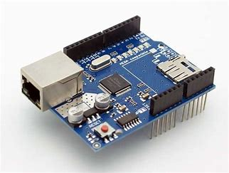
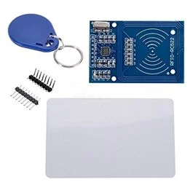
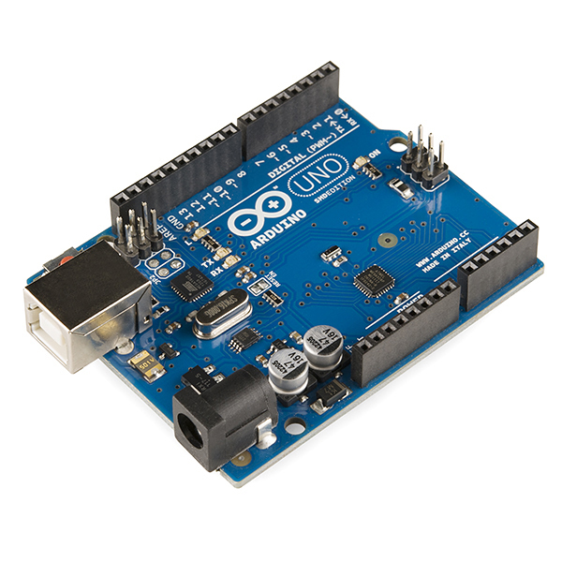
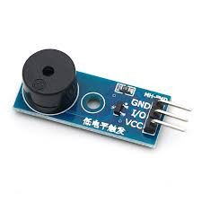
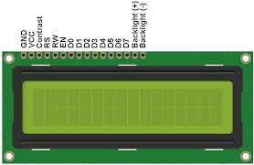
Components
Arduino UNO
Ethernet Shield Module
RFID RC522 reader with tags
LCD 16x2
Buzzer Module

Slide 11
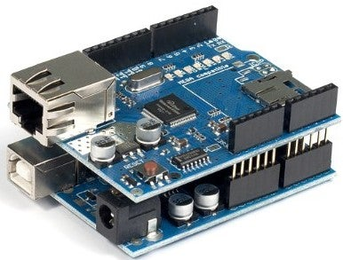
Connections
Arduino UNO
Ethernet Shield Module

Slide 12
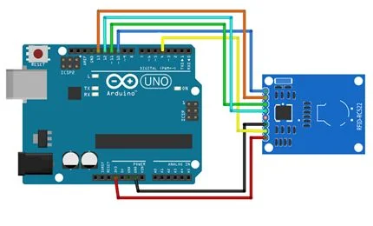
Circuit diagram
PIN WIRING
Pin | Wiring to Arduino Uno
SDA | Digital 4
SCK | Digital 13
MOSI | Digital 11
MISO | Digital 12
IRQ | Unconnected
GND | GND
RST | Digital 9
3.3V | 3.3V
Arduino to RFID reader

Slide 13
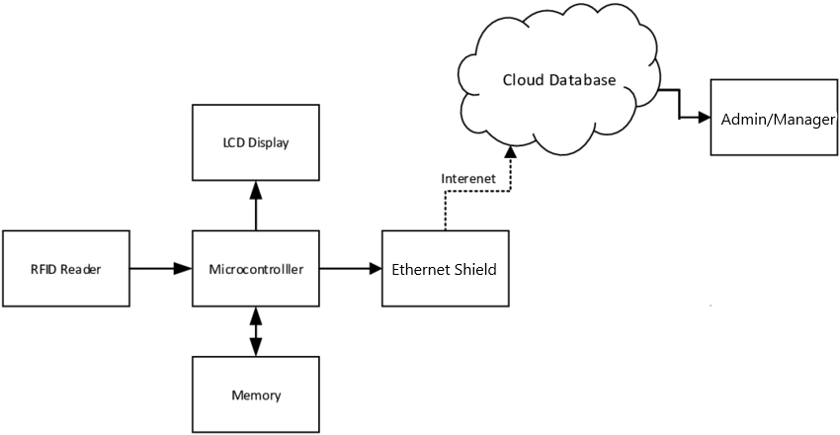
Architecture

Slide 14
Architecture Explanation
RFID tag is scanned by a RFID scanner
The scanned tag is verified through the microcontroller.
If the person is Id is verified and then its show valid, if not then it shows in valid.
Then the data is stored in the memory.
And the data is transferred through the internet with the help of ethernet shield and the data is showed in google spreadsheet.
Now the admin and the employee can check the data.

Slide 15
Flow Diagram
Start
Read signal from RFID
Scanning and matching ID
ID Matched?
ID Not Matched
Yes
No
Display ID
Store Attendance
End

Slide 16
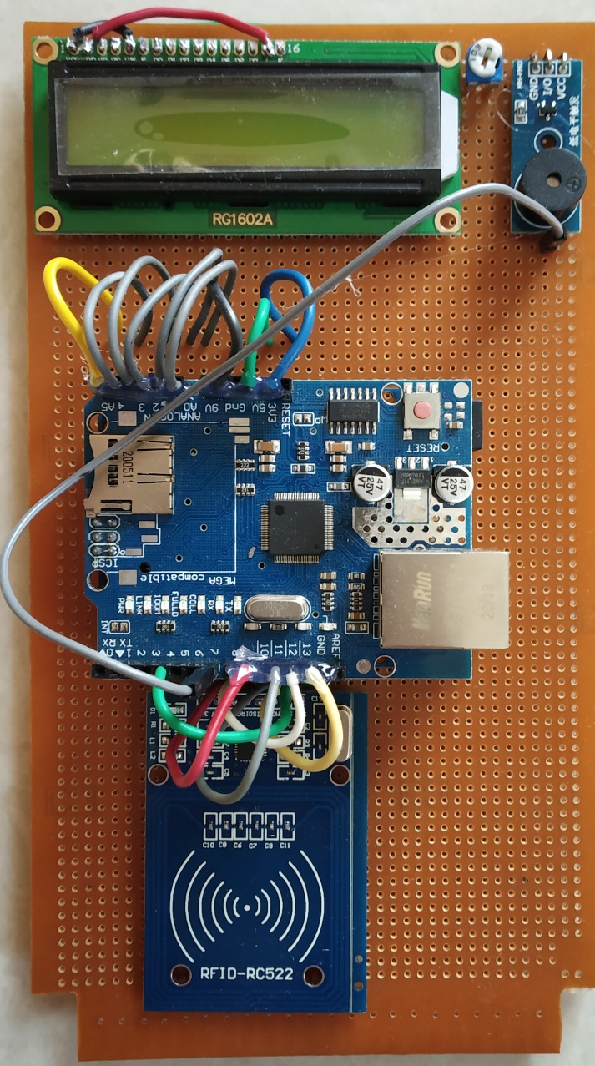
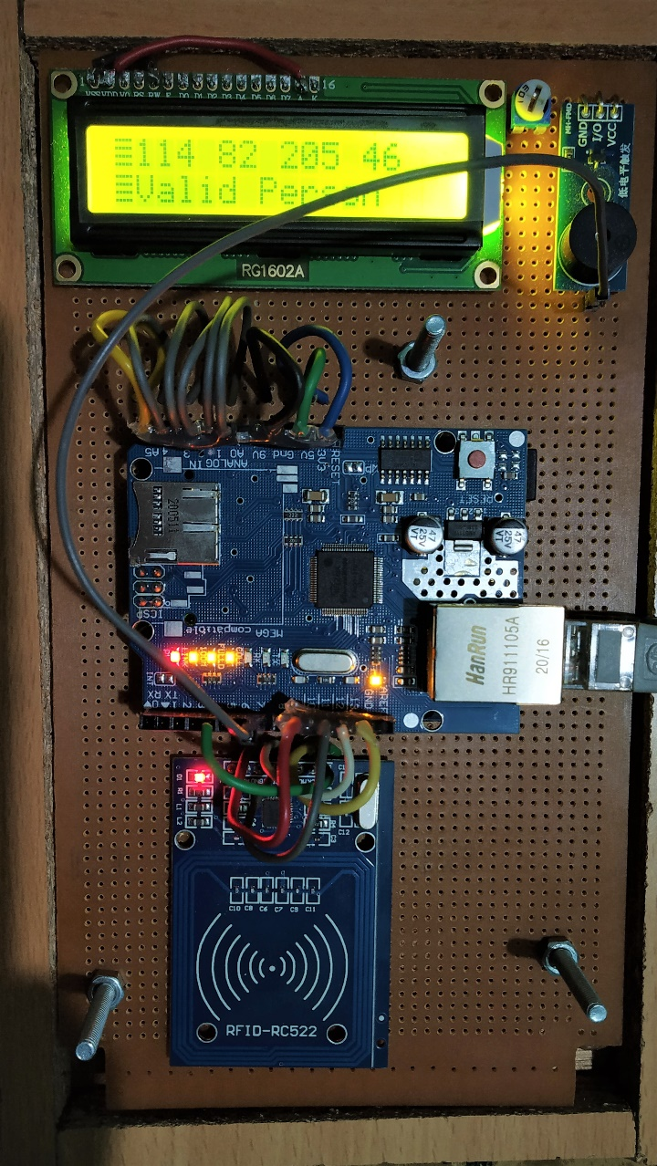
Screenshots

Slide 17
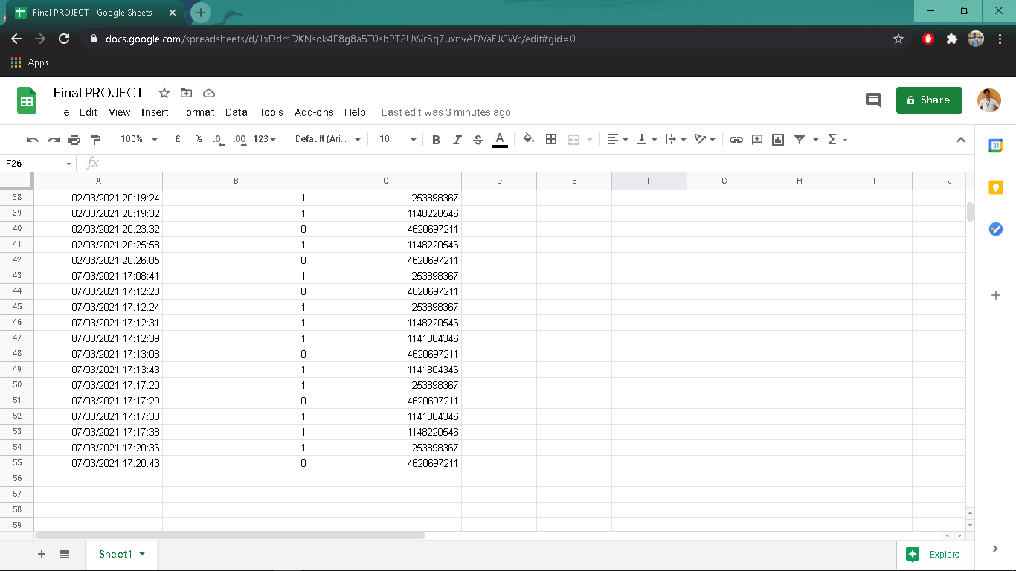
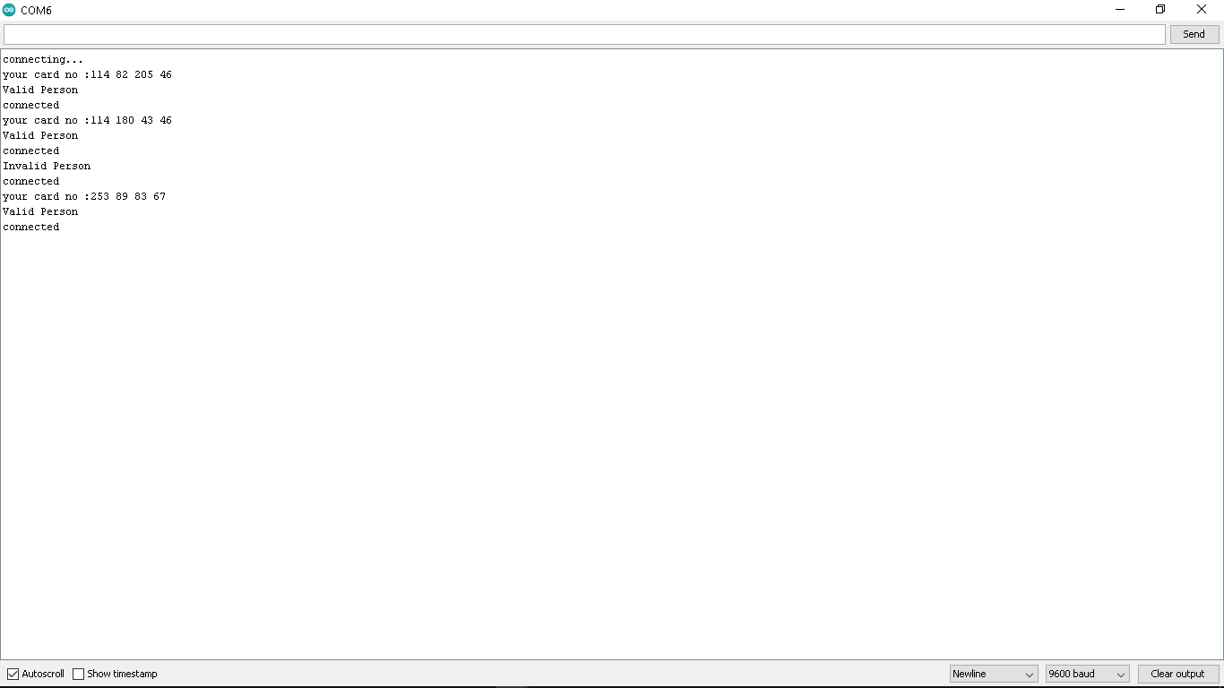
CONT…

Slide 18
Conclusion & Future Work
The system prototype has several advantages compared to the conventional method
The prototype is easy to use with switches and communication ports that are easily accessible. Participation can be easily stored and recovered. The high identification and verification speed is also an advantage of the system.
A single board design of hardware is on process.
Work on local backup .
Moving the validation from controller to script.

Slide 19

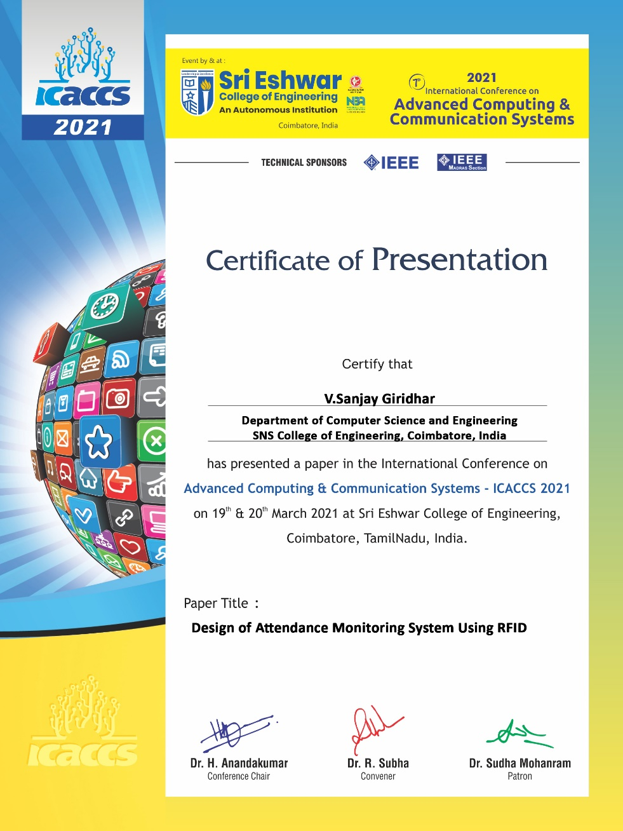

Conclusion

Slide 20

QUESTION TIME

Slide 21
THANK YOU

